Slide 1

Major Project-I (CA301P) Odd Semester Session 2025-26
PRISM- Productivity, Resource Insights and Sentiment Management
SHANTANU YADAV 2426MCA700 (Lead)
SHIVAM CHATURVEDI 2426MCA201
VINEET KUMAR 2426MCA199
SHYAM SUNDAR 2426MCA1971
Project In charge:
Dr. Amit Kumar
Dr. Saurabh Chaudhary
Mrs. Mahima Tayal
Mrs. Shalika Arora
Project Supervisor:
Ms. Shruti Aggarwal
Ms. Anita Yadav

Slide 2

PRISM Productivity, Resource Insights and Sentiment Management
Project Proposal by:
Shantanu Yadav
Shivam Chaturvedi
Shyam Sundar
Vineet Kumar

Slide 3

Introduction
Small and Medium Enterprises (SMEs) struggle with managing finance, HR, inventory, and CRM.
Current systems are fragmented and costly, limiting efficiency.
A cloud-based ERP solution offers centralized, affordable, and scalable management.

Slide 4

Problem Statement
• SMEs lack affordable and scalable ERP solutions.
• Existing tools are expensive, fragmented, or complex.
• Critical processes like payroll, billing, and inventory require automation.
• Need for a unified, cloud-based, and user-friendly ERP system.

Slide 5

Objectives
• Develop a modular ERP solution with Finance, HR, Inventory, CRM.
• Ensure scalability, security, and cost-effectiveness.
• Provide real-time reporting and analytics.
• Integrate custom-built communication and collaboration tools.

Slide 6
Methodology
1. Requirement Gathering
2. System Design (Architecture & Database)
3. Backend Development (Node.js REST APIs)
4. Frontend (React, Vue, Tailwind)
5. Database (MongoDB)
6. Communication Tools (Custom-built)
7. Deployment on AWS EC2 (Apache, CI/CD)
8. Testing & Feedback
9. Final Deployment

Slide 7
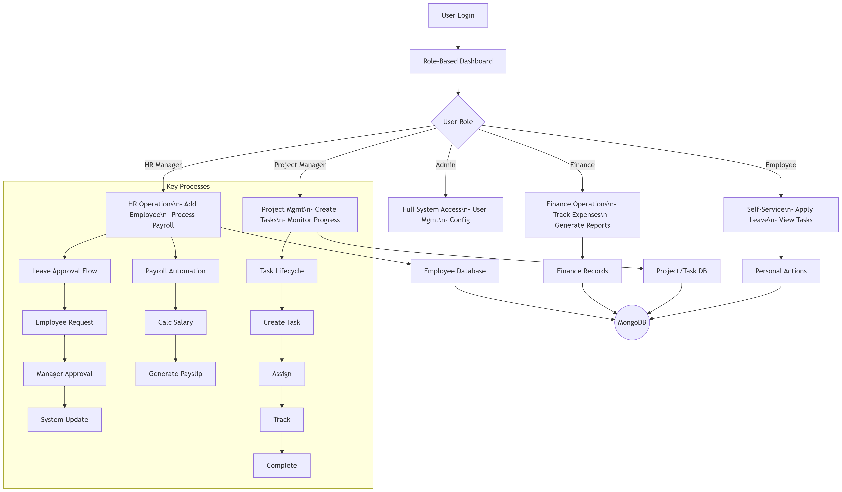
Flow chart

Slide 8
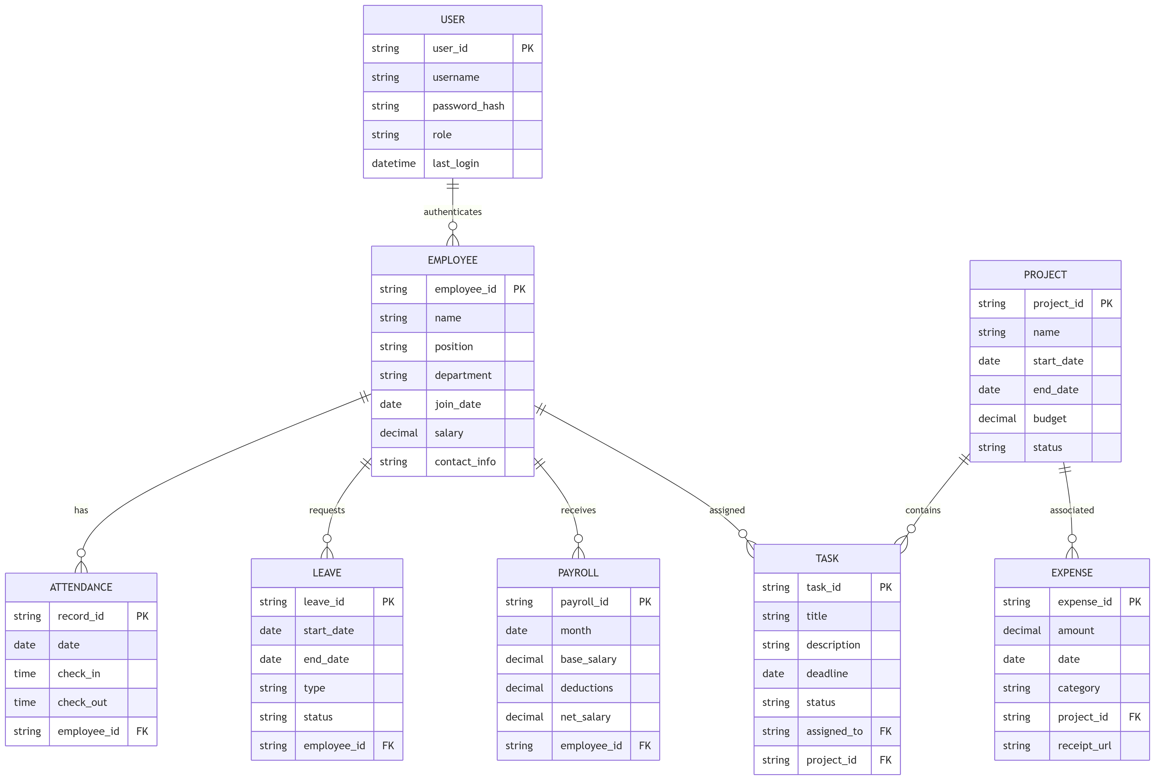
ER Diagram

Slide 9

Hardware & Software Resources
• Backend: Node.js REST APIs
• Frontend: React, Vue, Tailwind CSS
• Database: MongoDB
• Deployment: AWS EC2, Apache, CI/CD
• Tools: Own-built collaboration & communication system
• Hardware: Developer laptops, servers (AWS cloud)
• Testing: Virtual machines & staging environments

Slide 10

Expected Outcomes
• Centralized ERP system for SMEs
• Improved efficiency in Finance, HR, Inventory, CRM
• Reduced dependency on multiple costly tools
• Custom communication and collaboration module
• Scalable, secure, and affordable solution
• Real-time analytics and reporting
• Cloud-based deployment ensuring accessibility

Slide 11

References
1. Odoo ERP Documentation
2. ERPNext Open Source Framework
3. MongoDB & Node.js Docs
4. AWS EC2 Deployment Guide

